Slide 1
further improvement of rotate: remove unneed thread_ based on splitcore func

Slide 2
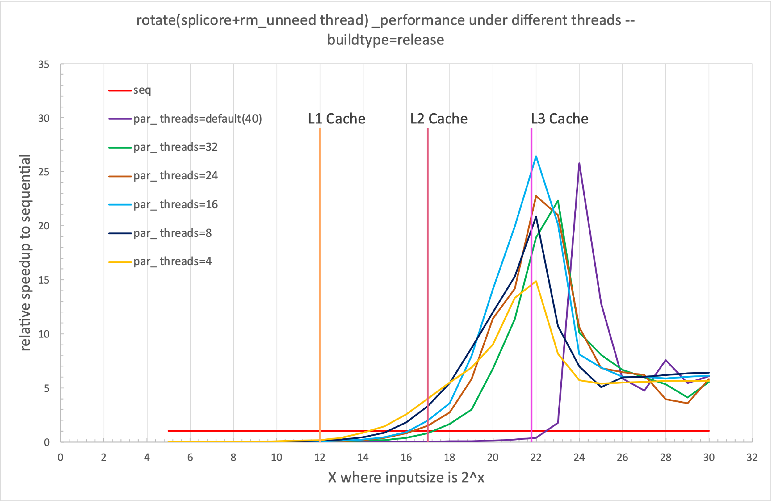

Slide 3
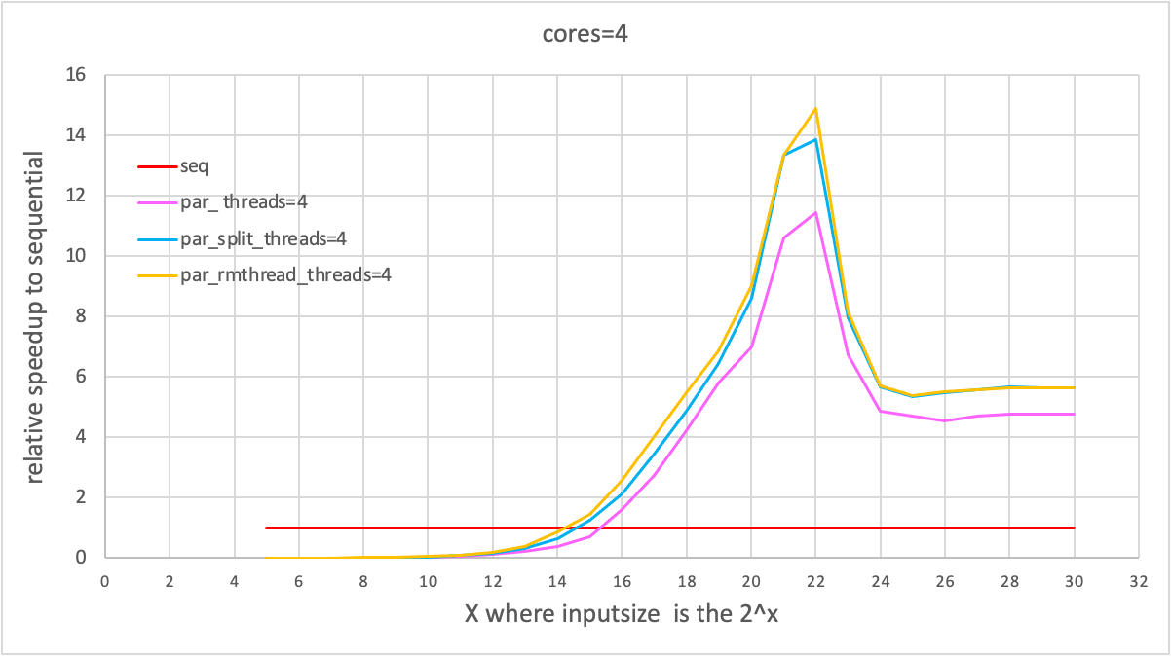
original vs. splitcores vs.remove_unneed thread

